Slide 1
Multiplication and Division

Slide 2
The Idea of Booth’s Algorithm
Booth’s algorithm was invented by Andrew D. Booth (1951) to:
Handle signed numbers correctly (2’s complement)
Reduce the number of addition/subtraction operations
Make multiplication faster

Slide 3
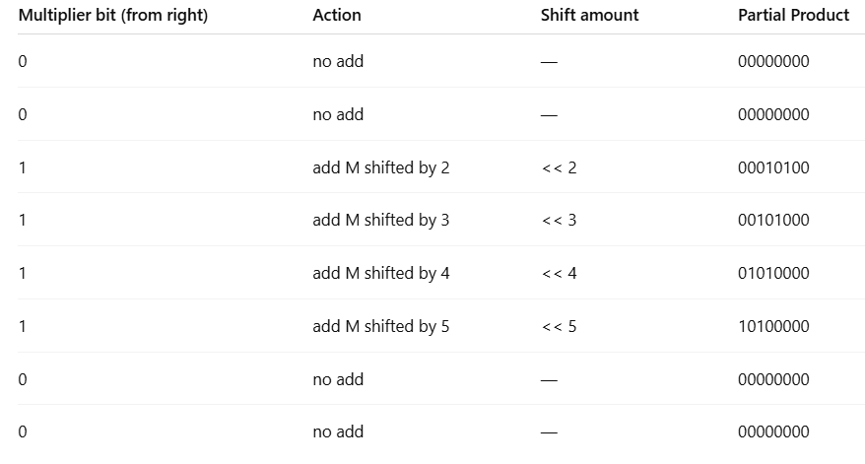
Normal Binary Multiplication
Multiplicand (M) = any number, say 5 → 00000101
Multiplier (Q) = 00111100
There are four consecutive 1s in the middle → that means:You must add the multiplicand (properly shifted) 4 times. Hence, “4 additions.”

Slide 4
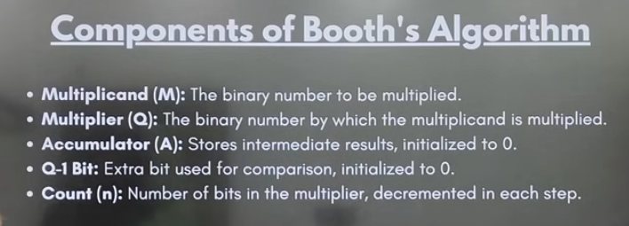

Slide 5
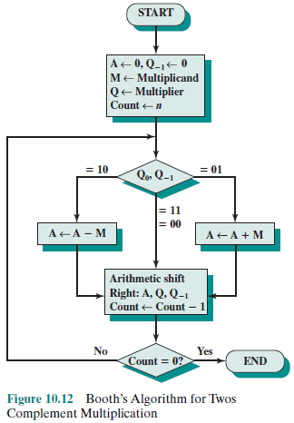
Multiplication: Booth’s Algorithm

Slide 6
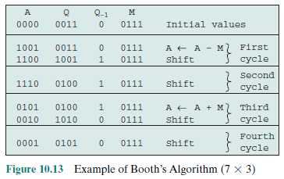
Multiplication: Booth’s Algorithm

Slide 7
Booth’s algorithm: 13X-6
M=13=01101 Q=-6=11010 -M=10011
A | Q | Q ₋₁ | M
00000 | 11010 | 0 | 01101 | Initial values
00000 | 01101 | 0 | 01101 | Shift Right-1st cycle
10011 10011 11001 | 01101 10110 | 0 1 | 01101 01101 | A=A-M [Subtract M from A(Adding 2’s complement of M)] Shift Right- 2nd cycle
01101 00110 00011 | 10110 01011 | 1 0 | 01101 | A=A+M Shift Right- 3rd cycle
10011 10110 11011 | 01011 00101 | 0 1 | 01101 01101 | A=A-M [Subtract M from A(Adding 2’s complement of M)] Shift Right- 4th cycle
11101 | 10010 | 1 | 01101 | Shift Right 5th cycle
Taking 2’s complement | 0001001110→78 Product=-78

Slide 8
Booth’s algorithm: 23X29
M=23=010111 Q=29=011101 -M=101001
A | Q | Q ₋₁ | M
000000 | 011101 | 0 | 010111 | Initial values
101001 101001 110100 | 011101 101110 | 0 1 | 010111 | A=A-M Shift Right-1st cycle
010111 001011 000101 | 101110 110111 | 1 0 | 010111 | A=A+M Shift Right- 2nd cycle
101001 101110 110111 | 110111 011011 | 0 1 | 010111 | A=A-M Shift Right- 3rd cycle
111011 | 101101 | 1 | 010111 | Shift Right- 4th cycle
111101 | 110110 | 1 | 010111 | Shift Right 5th cycle
010111 010100 001010 | 110110 011011 | 1 0 | 010111 | A=A+M Shift Right- 6th cycle
 | 001010011011→667 Product=667

Slide 9
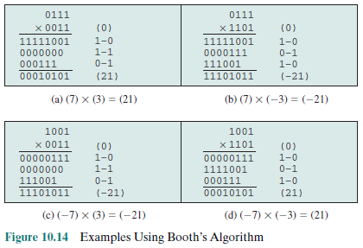
Multiplication: Booth’s Algorithm

Slide 10
How Booth’s algorithm works: +ve multiplier
Consider the case of a positive multiplier consisting of one block of 1s surrounded by 0s
M * (00011110) = M * (2⁴ + 2³ + 2² + 2¹) = M * (16 + 8 + 4 + 2)
= M * 30
M * (00011110) = M * (2⁵ - 2¹) = M * (32 - 2)
= M * 30
In general,
the product can be generated by one addition(Adding the content of 2⁵ place value) and one subtraction (Subtracting the content of 2¹ place value) of the multiplicand.
Booth’s algorithm conforms to this scheme by performing a subtraction when the first 1 of the block is encountered (1–0) and an addition when the end of the block is encountered (0–1).
M * (01111010) = M * (2⁶ + 2⁵ + 2⁴ + 2³ + 2¹)
= M * (2⁷ - 2³ + 2² - 2¹)

Slide 11
How Booth’s algorithm works: -ve multiplier
Let X be a negative number in twos complement notation: X = {1x_{n-2}x_{n-3} …..x₁x₀}
Then the value of X can be expressed as follows:
The leftmost bit of X is 1, because X is negative. Assume that the leftmost 0 is in the k^{th} position. Then,
And the value of X is:
From Equation
we can say that: 2^{n-2} + 2^{n-3} + ….+ 2^{k+1} = 2^{n-1} - 2^{k+1}
Rearranging: -2^{n-1} + 2^{n-2} + 2^{n-3} + ...+ 2^{k+1} = -2^{k+1} (10.7)
Substituting Equation (10.7) into Equation (10.6), we have
X = -2^{k+1} + (x_{k-1} * 2^{k-1}) + …+ (x₀ * 2⁰) (10.8)

Slide 12
How Booth’s algorithm works: -ve multiplier
Consider the multiplication of some multiplicand by (-6). In twos complement representation, using an 8-bit word, (-6) is represented as 11111010.
-6 = -2⁷ + 2⁶ + 2⁵ + 2⁴ + 2³ + 2¹
M * (11111010) = M * (-2⁷ + 2⁶ + 2⁵ + 2⁴ + 2³ + 2¹)
M * (11111010) = M * (-2³ + 2¹) which is equivalent to
  M * (11111010) = M * (-2³ + 2² - 2¹) [right to left:0-1→ - 2¹, 1-0→ +2², 0-1→-2³]

Slide 13
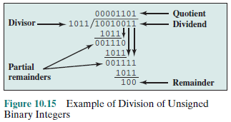
Division

Slide 14
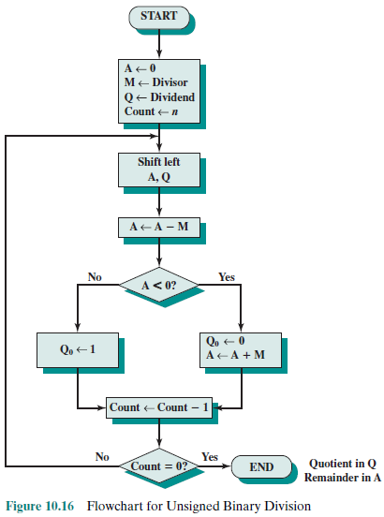
Division

Slide 15
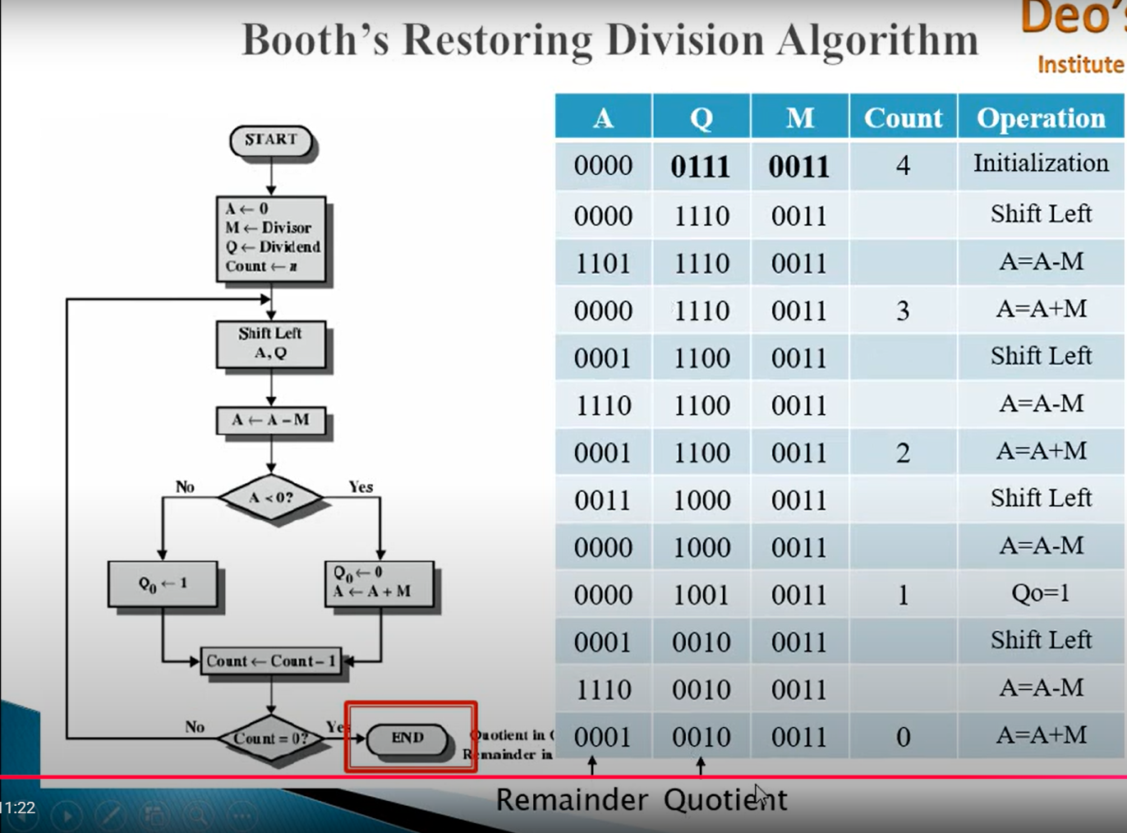

Slide 16
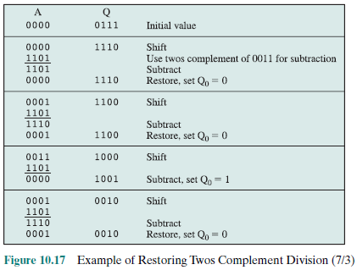
Division

Slide 17
Division: Algorithm
Assumption: divisor V and the dividend D are positive and that |V|< |D|.
If |V|= |D|, then the quotient =1 and the remainder=0.
If |V|> |D|, then Q=0 and R=D. The algorithm can be summarized as follows:
  Load the twos complement of the divisor into the M register; that is, the M register contains the negative of the divisor. Load the dividend into the A, Q registers. The dividend must be expressed as a 2n-bit positive number. Thus, for example, the 4-bit 0111 becomes 00000111.
  Shift A, Q left 1 bit position.
  Perform A=A-M. This operation subtracts the divisor from the contents of A.
    If the result is nonnegative (most significant bit of A=0), then set Q0=1
    If the result is negative (most significant bit of A=1), then set Q0=0, and restore the previous value of A.
  Repeat steps 2 through 4 as many times as there are bit positions in Q.
  The remainder is in A and the quotient is in Q.

Slide 18
Division: Example
Divide 8 by 3; M=-3=11101; Q=01000
A | Q
00000 | 01000 | Initial values
00000 11101 11101 + 00011 00000 | 10000 10000 10000 | Shift Left Subtract Divisor(Add 2’s complement of divisor) Set Q0=0 Restore 1st Cycle
00001 11101 11110 + 00011 00001 | 00000 00000 00000 | Shift Left Subtract Divisor(Add 2’s complement of divisor) Set Q0=0 Restore 2nd Cycle
00010 11101 11111+ 00011 00010 | 00000 00000 00000 | Shift Left Subtract Divisor(Add 2’s complement of divisor) Set Q0=0 Restore 3rd Cycle
00100 11101 00001 | 00000 00001 | Shift Left Subtract Set Q0=1 4th cycle
00010 11101 11111 + 00011 00010 | 00010 00010 00010 | Shift left Subtract Divisor(Add 2’s complement of divisor) Set Q0=0 Restore 5th Cycle

Slide 19
Division
Consider the following examples of integer division with all possible combinations of signs of D and V:
D = 7 V = 3 ➔ Q = 2 R = 1
D = 7 V = -3 ➔ Q = -2 R = 1
D = -7 V = 3 ➔ Q = -2 R = -1
D = -7 V = -3 ➔ Q = 2 R = -1
(-7)/(3) and (7)/(-3) produce different remainders.
The magnitudes of Q and R are unaffected by the input signs
The signs of Q and R are easily derivable from the signs of D and V.
  sign(R) = sign(D)
  sign(Q) = sign(D) * sign(V).
One way to do twos complement division is to convert the operands into unsigned values and, at the end, to account for the signs by complementation where needed.
This is the method of choice for the restoring division algorithm.

Slide 20
Exercise
Given x and y in twos complement notation i.e., x=0101 and y=1010,compute the product p=x*y with Booth’s algorithm
Use the Booth algorithm to multiply 23 (multiplicand) by 29 (multiplier), where each number is represented using 6 bits
Divide 145 by 13 in binary twos complement notation, using 12-bit words. Use the restoring division algorithm

